Slide 1


SUPER STORE SALES DASHBOARD

Slide 2
OBJECTIVE :
To contribute to the success of a business by utilizing data analysis techniques, specifically focusing on time series analysis, to provide valuable insights and accurate sales forecasting.
The objective can be broken down into the following detailed components:
Dashboard Creation:
Identify the KPIs, design an intuitive and visually appealing dashboard, add interactive visualizations and filtering capabilities to allow users to explore the data at various levels of granularity.
2. Data Analysis:
Provide valuable insights to business entities regarding the effectiveness of their sales strategies through visualization and charts.
3. Sales Forecasting:
Leverage historic data and apply time series analysis to generate sales forecasts for next 15 days.

Slide 3
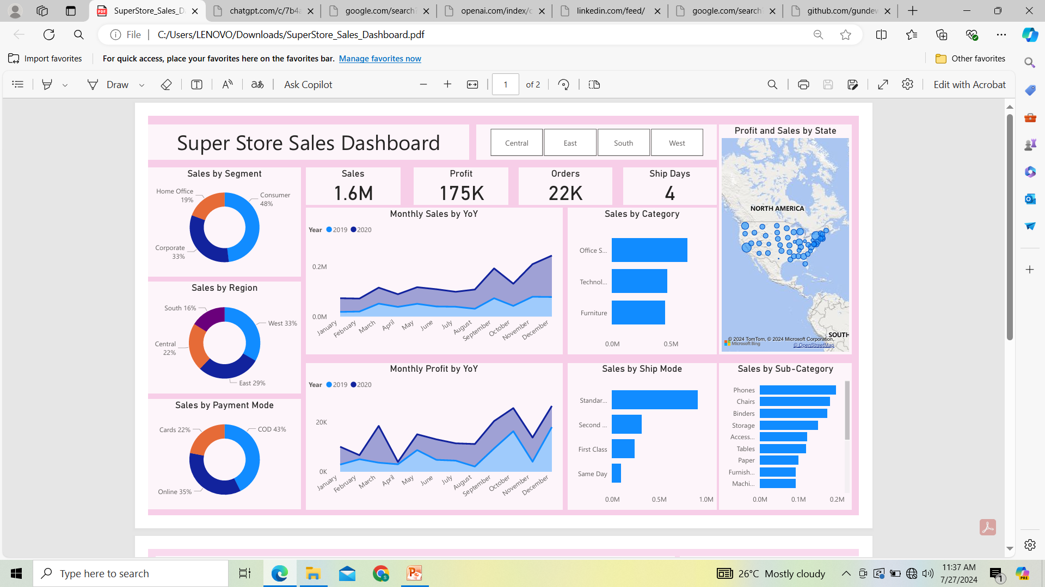
Pie chart showing the distribution of sales by Segment, Region and Payment Mode.
Content:
Home Office: Explanation of the sales performance for Home Office segment, trends observed, and comparison with other segments.
Customer: Insights into sales data for the Customer segment, highlighting key findings.
Corporate: Overview of sales in the Corporate segment, emphasizing significant patterns and deviations.
Content:
East: Detailed analysis of sales in the East region, noting any anomalies or successes.
West: Examination of sales trends in the West region, identifying high-performing areas and any issues.
South: Review of sales data in the South region, highlighting key metrics.
Central: Summary of sales performance in the Central region, pointing out any significant observations.
Content:
Online: Analysis of online sales, trends, and customer behavior.
COD (Cash on Delivery): Insights into sales through COD, including customer preferences and sales trends.
Cash: Overview of sales made via cash payments, identifying any key trends or patterns.

Slide 4
Area Chart for Monthly Sales and Profit Comparison (2019 vs 2020) :
1. Axes:
X-axis: This represents the months of the year (January to December).
Y-axis: This represents the sales figures.
2. Areas:
Area for 2019: This light blue area shows the sales figures for each month in 2019.
Area for 2020: This dark blue area shows the sales figures for each month in 2020.
1. Axes:
X-axis: This represents the months of the year (January to December).
Y-axis: This represents the profit figures.
2. Areas:
Area for 2019: This light blue area shows the profit figures for each month in 2019.
Area for 2020: This dark blue area shows the profit figures for each month in 2020.

Slide 5
Bar Chart for Sales by Category
1. Axes:
X-axis: Represents sales figures.
Y-axis: Represents different product categories (e.g., Furniture, Office Supplies, Technology).
2. Bars:
Each bar corresponds to a category and its width represents the total sales for that category.
Bar Chart for Sales by Ship Mode
1. Axes:
X-axis: Represents sales figures.
Y-axis: Represents different shipping modes (e.g., Standard Class, Second Class, First Class, Same Day).
2. Bars:
Each bar corresponds to a shipping mode and its width represents the total sales for that mode.
Bar Chart for Sales by Sub-Category
1. Axes:
X-axis: Represents sales figures.
Y-axis: Represents different product sub-categories (e.g., Chairs, Tables, Binders, Phones).
2. Bars:
Each bar corresponds to a sub-category and its width represents the total sales for that sub-category.

Slide 6
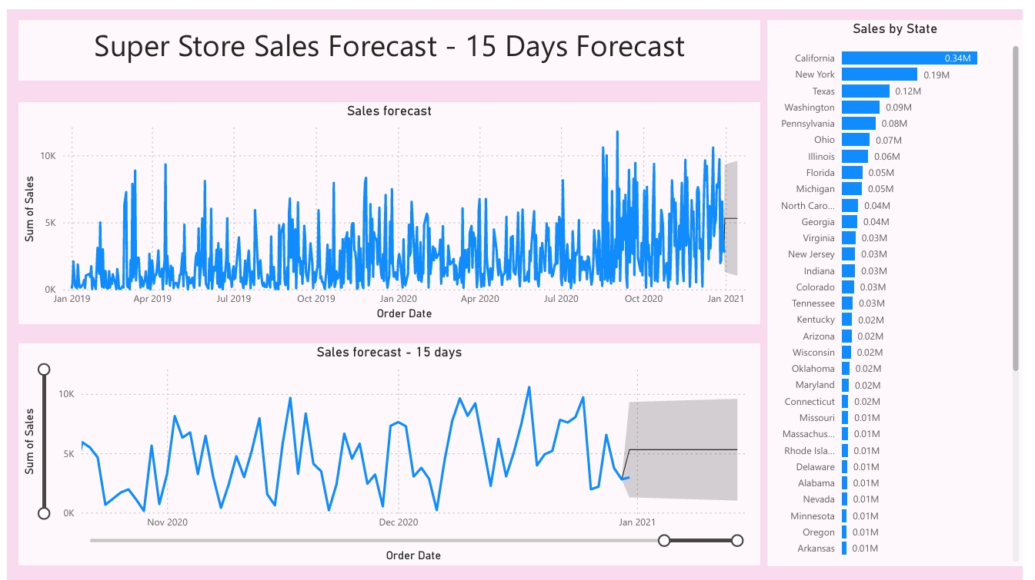
A sales forecast line chart is a powerful tool for predicting future sales based on historical data and trends. This chart can help businesses plan for upcoming demand, allocate resources efficiently, and make informed decisions. Here’s a detailed explanation of the sales forecast line chart:

Slide 7
Sales Forecast :
Axes:
X-axis: Represents the order dates, typically spanning past, present and future dates.
Y-axis: Represents the sales figures, usually in monetary units.
2. Lines:
Historical Sales Line: This line plots the actual sales data up to the current date. It shows the historical performance of sales.
Forecast Line: This line extends from the current date into the future, showing predicted sales figures based on historical trends and forecasting models.
3. Components:
Historical Data: Provides a basis for the forecast by showing past sales trends.
Forecast Data: Uses historical data to project future sales, helping to predict how sales will trend over time.

Slide 8
Bar Chart for Sales by State
1. Axes:
X-axis: Represents the sales figures, usually in monetary units.
Y-axis: Represents the different states.
2. Bars:
Each bar corresponds to a specific state, with the width of the bar representing the total sales for that state.
3. Interpretation:
Comparison: Compare the widths of the bars to see which states generate the most and least sales.
Trends: Identify any regional trends, such as whether certain areas have higher sales performance.

Slide 9
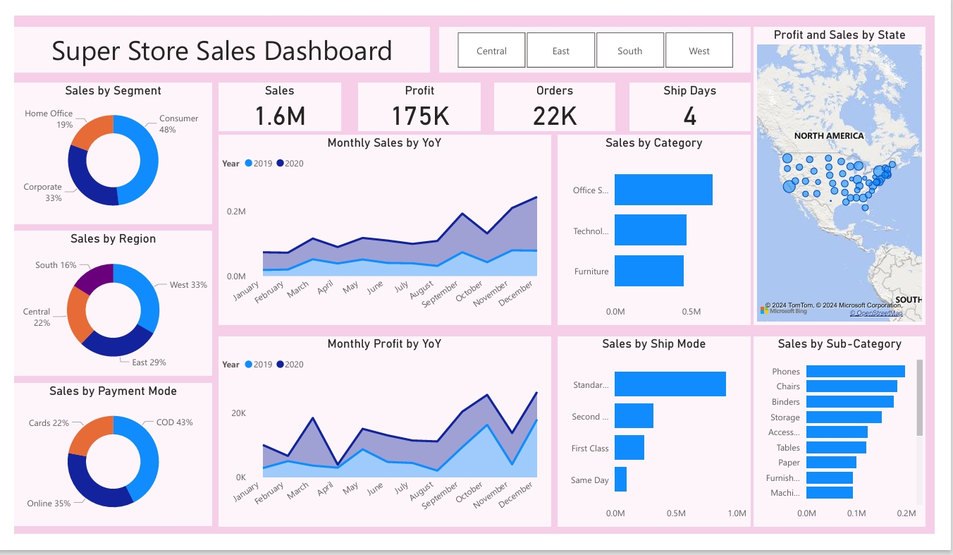
DASHBOARD OVERVIEW :

Slide 10
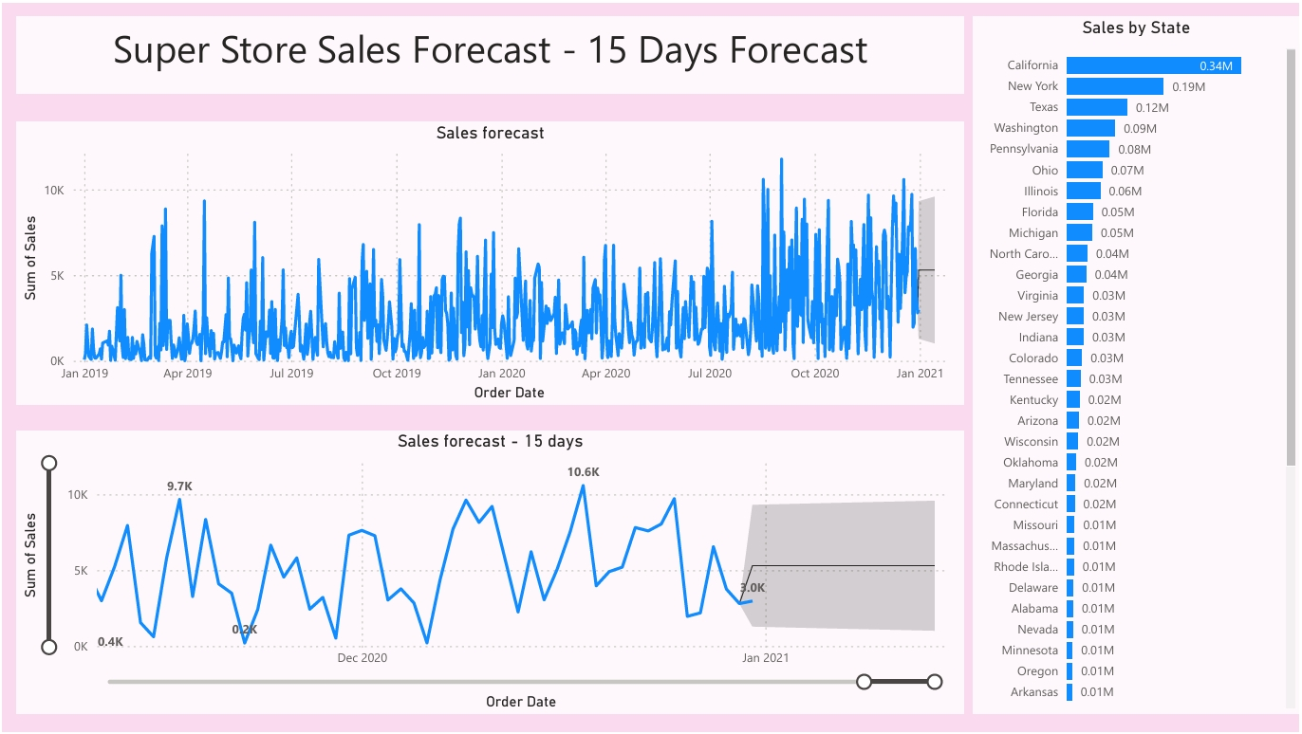
SALES FORECAST :

Slide 11
Learning:
Incorporated data analysis techniques, specializing in time series analysis, to deliver valuable insights, accurate sales forecasting, and interactive dashboard creation, driving business success.

Slide 12
THANK YOU !

